Slide 1

AUTODESK CONSTRUCTION CLOUD
REVIT University
SHARING MODELS THROUGH DESIGN COLLABORATION
ORB UNIVERSITY – MAY 24, 2023
PRESENTED BY Christian Quintero

Slide 2
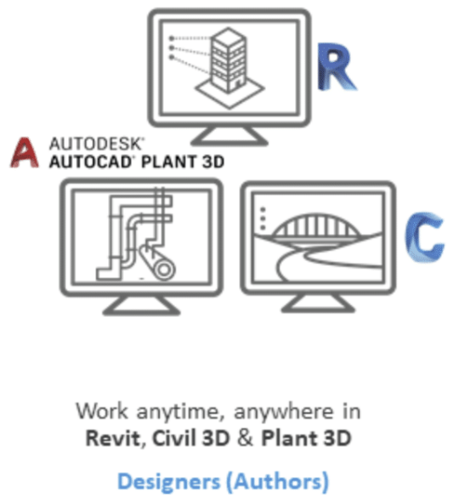
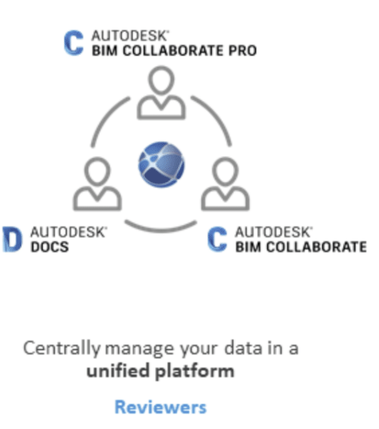
ACC CLOUD
The ACC cloud environment is a project management workflow created by Autodesk. Its main function is to facilitate the exchange of data between disciplines, as well as extracting information from BIM Models. The three main components of it are design software, project management/coordination platforms, and field management software.

Slide 3

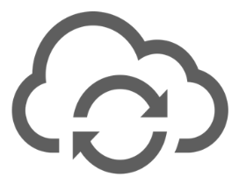


Autodesk Collaboration Cloud
The collaboration cloud is where most of the documentation files live and are interacted with. In our case this also includes the exchange of Revit Models and Cad files with consultants that work on the ACC cloud. Inside of this platform is where Autodesk Docs resides; which lets you coordinate archives of the live model.
Model Cloud

Slide 4
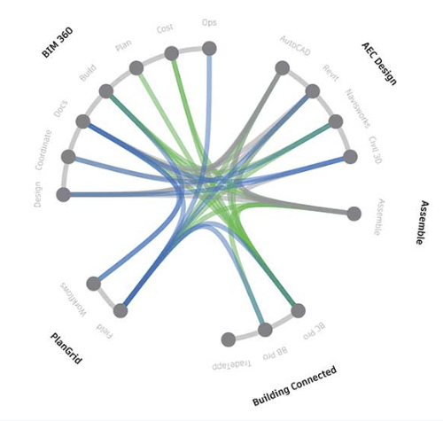

Slide 5
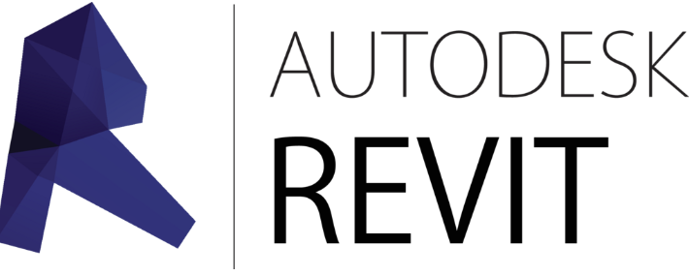
Workflow – Initial Upload
On initial Model Hosting you will save the model as a Cloud Model into the ACC Cloud Docs area. The platform will also create a copy into the Model Cloud automatically. The cloud saved model is where you sync to while using Revit. The Model on Autodesk Docs is an archive of the cloud saved model at a specific time.
Model Cloud

Slide 6
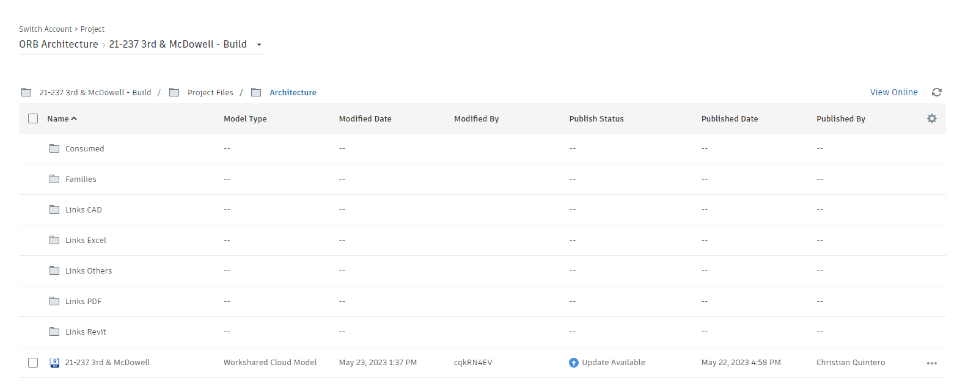
Workflow – Initial Upload
When a user navigates through its Revit Account’s projects, you will see the Cloud Hosted Model, even though you are seeing the project folder structure created in Autodesk Docs.

Slide 7

Workflow
Model Cloud

Slide 8
Publishing From Revit To ACC Docs
Model Cloud

Slide 9
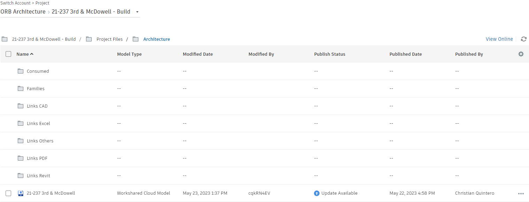
Publishing From Revit To ACC Docs
To publish select the Main model and click on publish at the top left. If the model is not selected, this option will not appear.

Slide 10
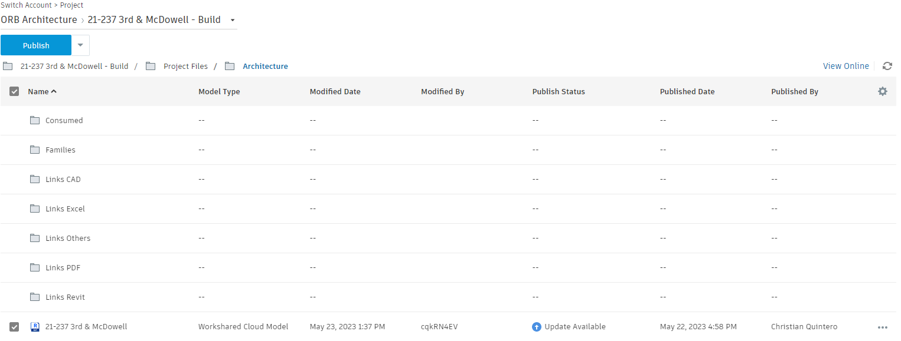
Publishing From Revit To ACC Docs
To publish select the Main model and click on publish at the top left. If the model is not selected, this option will not appear.

Slide 11
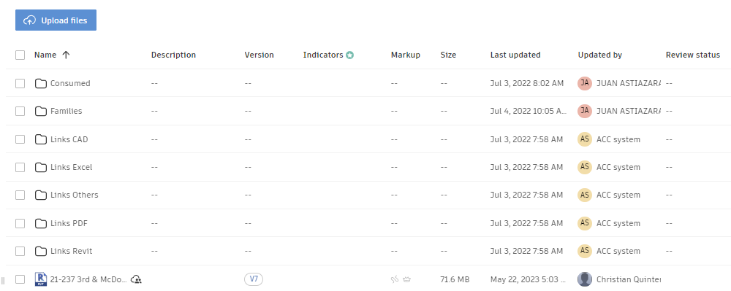
Publishing From Revit To ACC Docs
Once this is achieved the model version count will go up and the dates will update. Doing this will effectively create a saved point of your project. This process can be automated if desired.

Slide 12
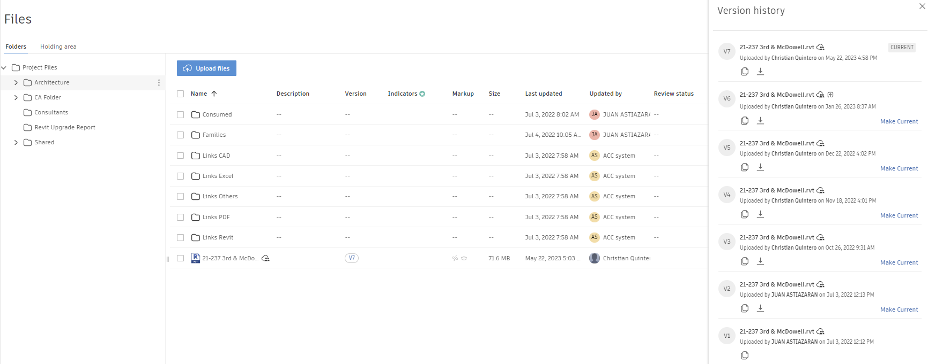
Publishing from Revit To ACC Docs
You can access any previous publishes of the model through the Version Icon next to the Cloud Shared Model. From there you can download or make current any of the older versions.
Note: This will only make the model current in ACC Docs, not the Cloud Model.

Slide 13
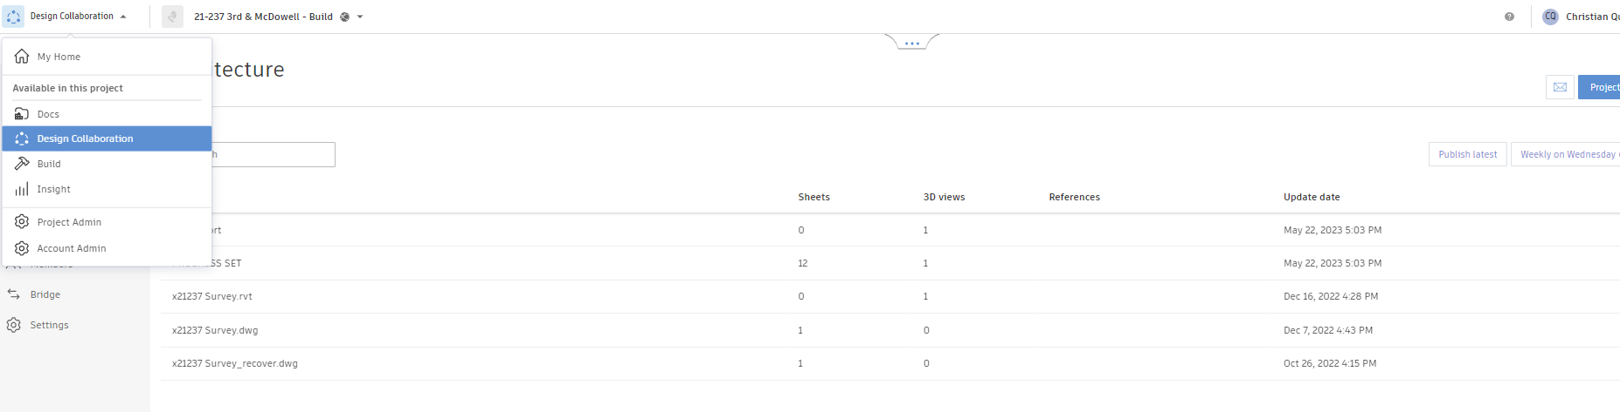
Sharing from ACC Docs to Consultants
To share one of these saved points from ACC Docs with one of our consultants you will need to crate or re-use a package and send it to them. To achieve this, go to the Design Collaboration tab and open the collaboration time laps ribbon.

Slide 14
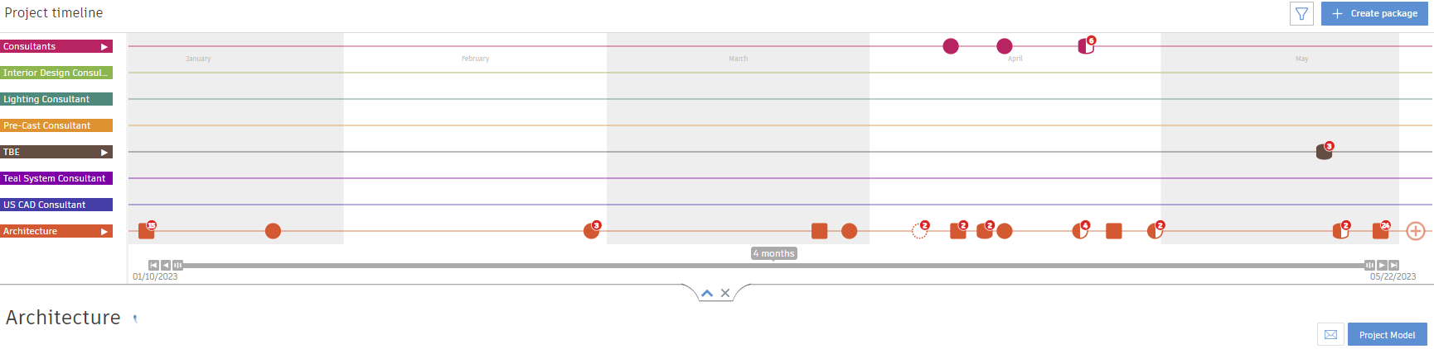
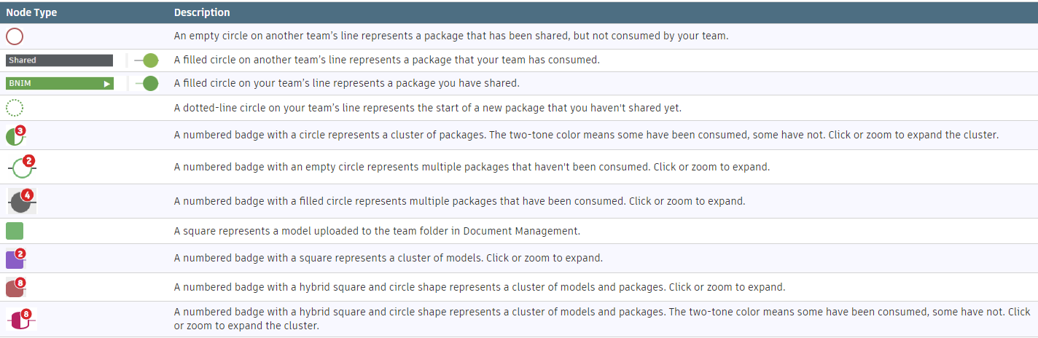
Sharing from ACC Docs to Consultants
At the Project Timeline graphic, you will see the History of all shared packages and publishes from each respective discipline.
DICIPLINES

Slide 15
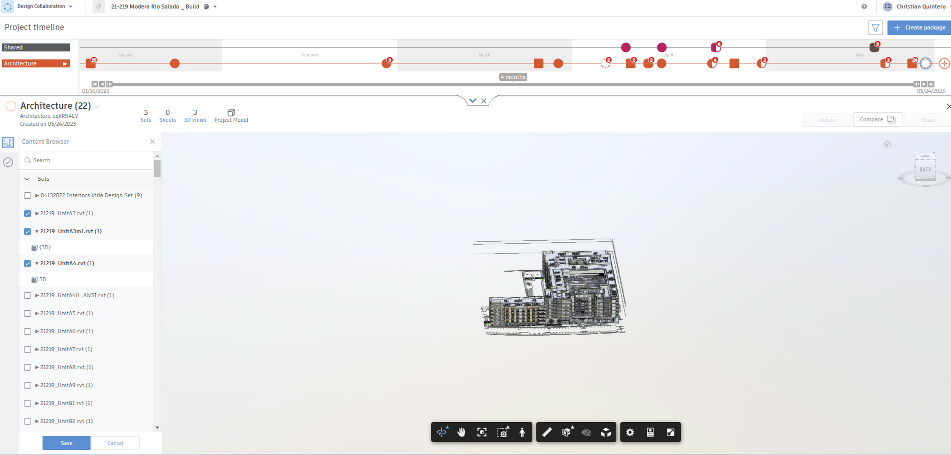
Sharing from ACC Docs to Consultants
Once a package has been created select the models you want to send out from the left-hand side column and hit the save button at the bottom left. After the package has been saved ACC will let you share it on the top-right.
PROJECT MODELS

Slide 16
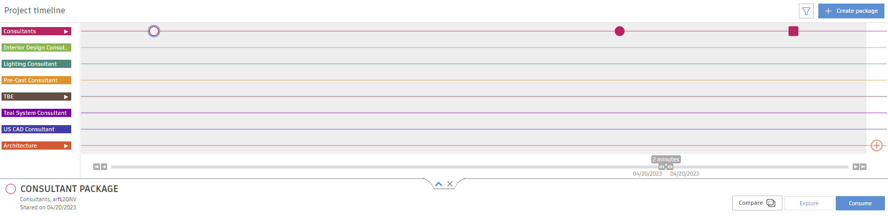
Receiving a model from Consultants
To receive a model from a consultant simply go to the Project timeline and click on an un-consumed package. You will get the option to consume it on the bottom right of the package.
CONSUMED = ACCEPT

Slide 17
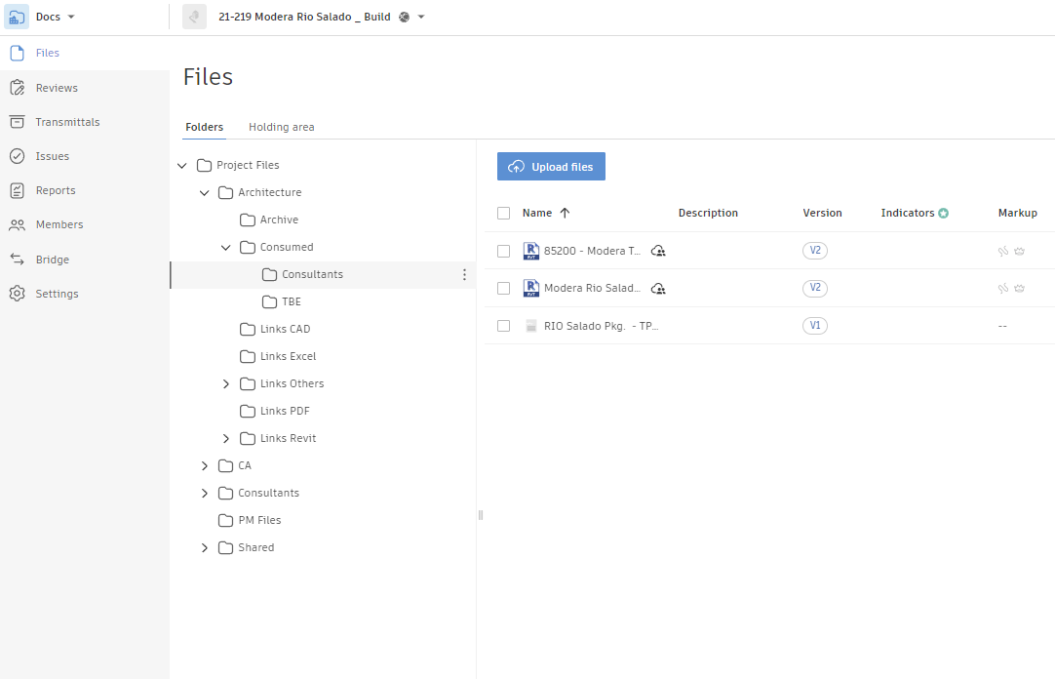
Consumed Models
Consumed models can be linked or reviewed from the consumed folder under our Architecture Team’s Root Folder. Under Consumed there will be a folder for each one of the disciplines we’ve accepted models from. This is the only area where we should be linking shared models from.

